Slide 1
RSG ActivitySim Progress
ActivitySim Consortium Meeting
July 26, 2022

Slide 2
Outline
Disaggregate Accessibilities
Current status
Results
Example using flexible tour & trip IDs
Status of shadow pricing

Slide 3
Accessibilities

Slide 4
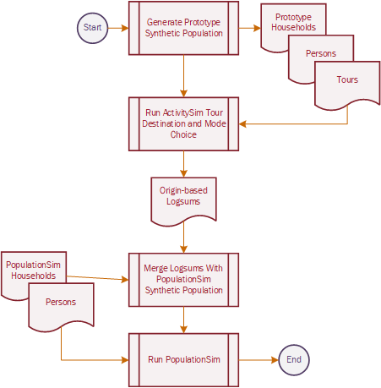
Current Progress
Generate a user defined proto-population [Complete]
Run ASIM models and extract logsums [complete]
Merge logsums back onto full population [in progress]

Slide 5
Model outline
Run as separate process using script disaggregate_accessibility_model.py
Currently outputs CSV files with the accessibilities
optional injection step compute_disaggregate_accessibilities calls the standalone model in a separate process [NOT optimized for memory/cpu]
models/disaggregate_accessibilities.py
YAML config
Annotation tables
Generate proto-population
Imported from activitysim
location_choice.run_location_choice() [work/school]
tour_destintion.run_tour_destination() [non-mandatory]
Get disaggregate logsums
Mandatory destination
Non-mandatory destination
Model config YAML settings and csv tables
School
location
Work location
Modified in from activitysim
interaction_sample_simulate() [added escape flag ‘skip_choice’ to skip rand choice and return logsums]
Logsums

Slide 6
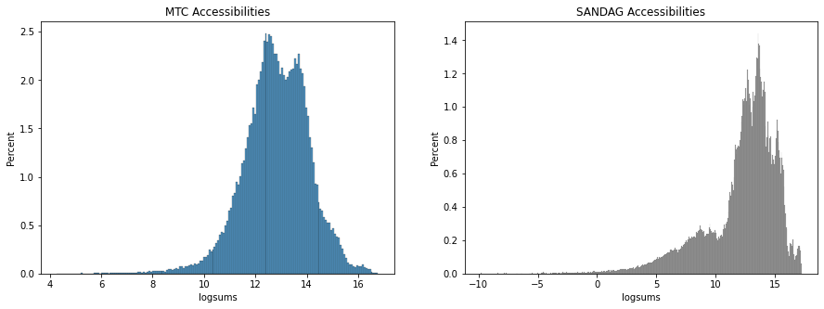
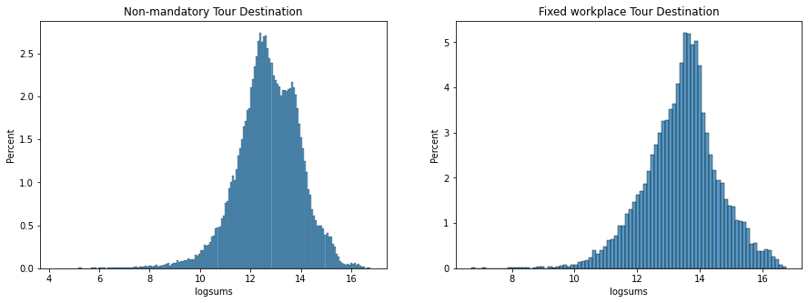
Results

Slide 7
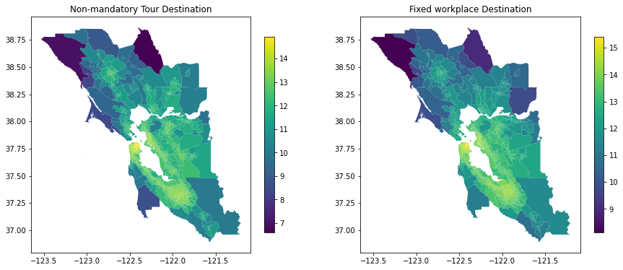
Results

Slide 8
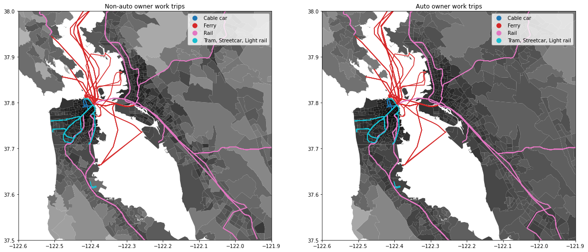
Results
Auto ownership

Slide 9
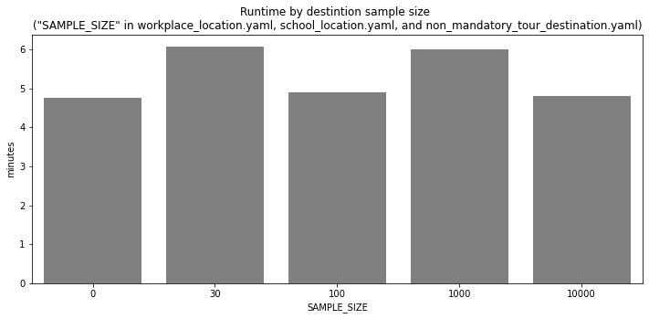
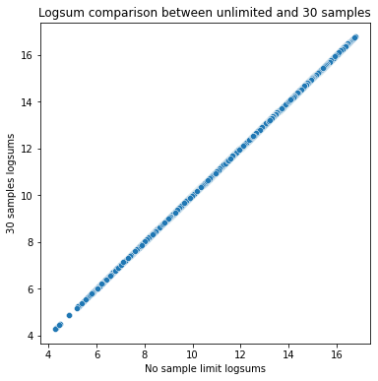
Results
Runtime is about 5-6 minutes (the proto-pop is very simple)
Adjusting SAMPLE_SIZE parameter in location configs had little impact on runtime
Need to inspect this further…
0 = no sample limit

Slide 10
Next steps: Disaggregate Accessibilities
Finalizing development of work/school location (location_choice.py)
Continue process for non-mandatory_destination.py
Investigate sampling
Merge accessibilities with full population
Test in 2-zone system (SANDAG)
SANDAG: model estimation with disaggregate accessibilities

Slide 11
Flexible Tour & Trip IDs

Slide 12
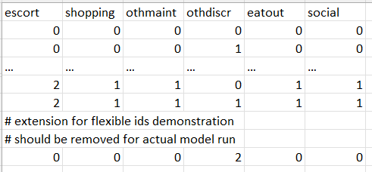
Incorporating Flexible IDs Into Example
In scope to provide a test model with tour and stop frequency extensions
Extended the non-mandatory tour frequency alternatives to contain 2 “other discretionary” tours
No spec file changes needed and verified that the alternative was selected in the example model

Slide 13
Incorporating Flexible IDs Into Example
Extended stop_frequency_alts.csv to 4 outbound and 4 inbound stops.
This was then included in the stop_frequency_othdiscr.csv spec with an additional calibration constant to provide ensure the alternative is selected in the small example dataset
Had to copy the trip scheduling probabilities for the 4th outbound trip for the now possible 5th trip

Slide 14
Flexible Tour & Trip ID Status
Pull request is ready for review
Includes the config changes just discussed for the prototype_mtc_extended example
Includes updated documentation for that example explaining these config changes
Includes unit testing of flexible tour & trip ID functionality
School Escorting pull request adds additional changes to the canonical_ids.py script for extra escorting tours

Slide 15
Shadow Pricing

Slide 16
Status
Multiprocessing interfered with sampling of workers in each iteration.
The fix is in: created a shared data structure across all processes to be able to aggregate choices and then sample extra workers
Current ActivitySim functionality just sums across zones to compute shadow prices
We need to keep track of the actual choices of each person in order to select those that need to be re-sampled for each zone
Tested an implemented solution, and it works.
Hope to have updated shadow price convergence results to share next Thursday

Slide 17
Questions/Discussion

Slide 18
Joel Freedman
Senior Director
Joel.Freedman@rsginc.com

Slide 19
Accessibilities
Usual Work, K-12, Univ. Location
Transit Subsidy Model
Transit Pass Model
Auto Ownership
Vehicle Type Model
Free Parking Eligibility
Telecommute
Coordinated Daily Activity Pattern
Mandatory
Fully Joint
Indiv. Non-Mand.
At-Work
Frequency
Frequency
Frequency
Frequency
Composition
Participation
Scheduling
Destination
Destination
Destination
School Dropoff/Pickup
Scheduling
Scheduling
Scheduling
Vehicle Availability Model
Mode
Stop Frequency
Purpose
Aggregate
Destination
Long-Term/Mobility
Scheduling
Person Daily
Mode
Tour
Write Trip Matrices
Trip

